Slide 1
Wild peacock website
Functional Explanation

Slide 2
Explanation of possible requirements
Home
Deli
Wholesale
Latest news
Blog
About
Contact
Social
A way to manage the content

Slide 3
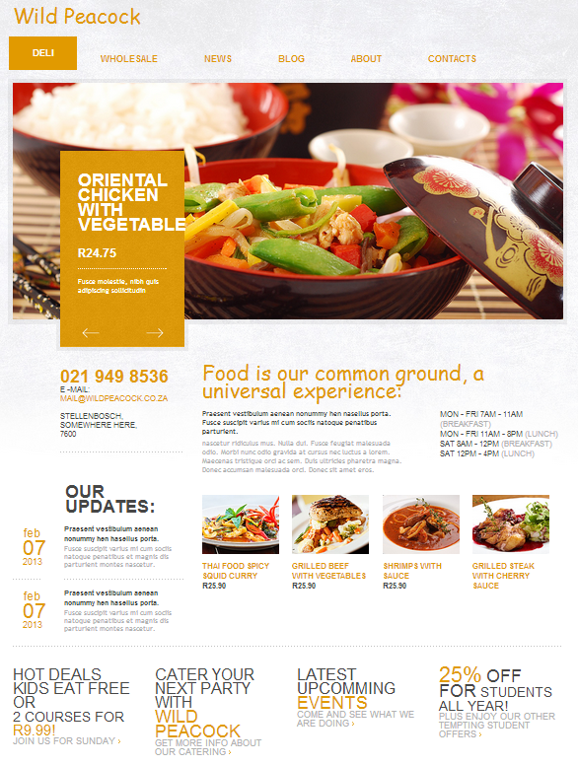
Home
Trading Times
Week specials
Images and prices
Promotional specials
Student specials
2 for one night
Latest updates
Blow entry preview
Provided services
catering

Slide 4
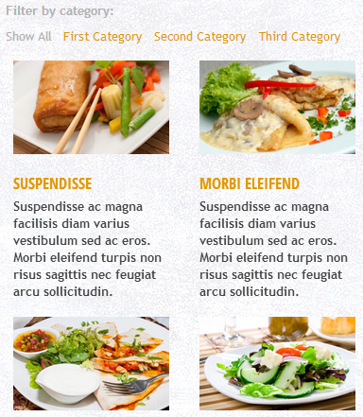
Deli
Needs for categories
Wine
Meat
Cheese
Categories needs filters
Example wine:
Red, white, farm, year,…
Each Item needs a :
Heading,
Description
Optional photo
Optional wine pairing

Slide 5
Wholesale
Something about what we do
Contact details
Product
Available list
Download of list
Services provided
Catering
Delivery
Frequently asked questions
Online entry form that send a email

Slide 6
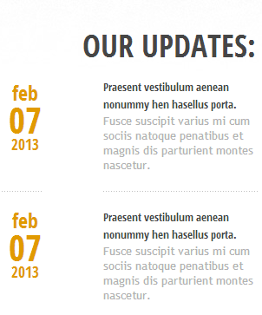
Latest news
Updates on what is going on
Competitions
events
gigs
speakers
book readings
wine tasting
Subscription mail for newsletters and updates

Slide 7
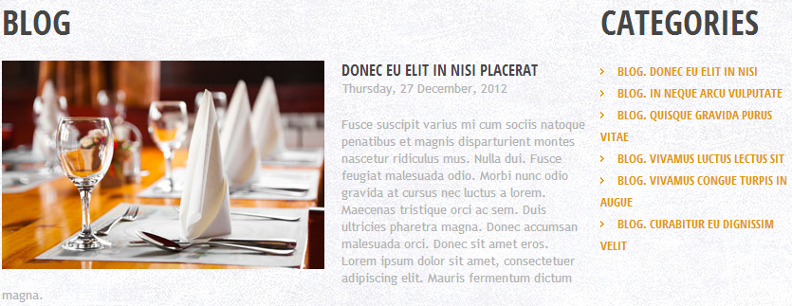
Blog
Blog on what is trending or new
Comments on entries
Subscription to blog entries

Slide 8
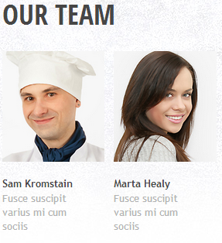
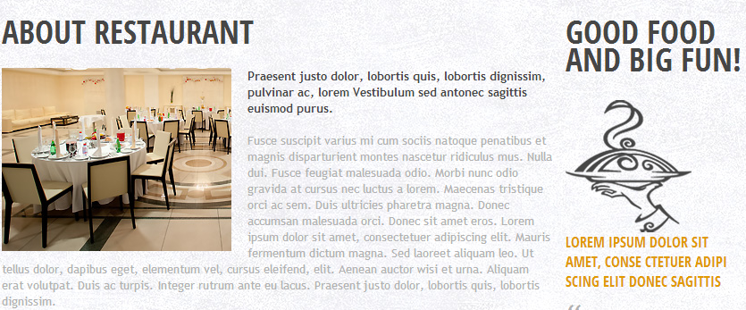
About
About the restaurant
Introduction to team
Motto
Brief history
Testimonials and reviews
Frequently asked Questions

Slide 9
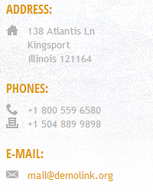
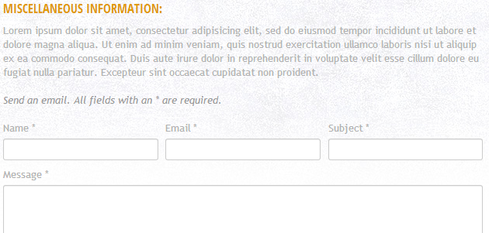
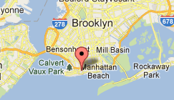
Contact
Address and map
Phone
Mail
Miscellaneous information
Contact online form to email

Slide 10
Social
Facebook
Like button
Share
Twitter
Twitter link
Twitter feed on page
Share on twitter
There are a lot more available( yahoo, Pinterest, blogger, email, AOL, hotmail, stumbleUpon)

Slide 11
A way to manage the content
Add new products
Blog
Write news
Add staff
Add history
Delete products
Changes specials
Really all that you see, you will need to be able to change.

